Slide 1
Lecture 33
Introduction to Memory Management
Dr. Ehtesham Zahoor
National University of
Computer & Emerging Sciences

Slide 2
Background
Program must be brought (from disk) into memory and placed within a process for it to be run
A programmer will like to have memory
  Infinitely large
  Infinitely fast
  Non volatile
However, we have Memory Hierarchy:
Registers
Cache
Main Memory
Disk

Slide 3
Memory Manager
The part of the OS that manages the Memory Hierarchy
  Which part of memory is in use and which is not in use
  Allocate memory
  De-allocate memory
  Swapping between main memory and disks

Slide 4
Binding of Instructions and Data to Memory
Address binding of instructions and data to memory addresses can happen at three different stages
  Compile time: If memory location known a priori, absolute code can be generated; must recompile code if starting location changes
  Load time: Must generate relocatable code if memory location is not known at compile time
  Execution time: Binding delayed until run time if the process can be moved during its execution from one memory segment to another
    Need hardware support for address maps (e.g., base and limit registers)

Slide 5

Multistep Processing of a User Program

Slide 6
Logical vs. Physical Address Space
The concept of a logical address space that is bound to a separate physical address space is central to proper memory management
  Logical address – generated by the CPU; also referred to as virtual address
  Physical address – address seen by the memory unit
Logical and physical addresses are the same in compile-time and load-time address-binding schemes;
logical (virtual) and physical addresses differ in execution-time address-binding scheme
Logical address space is the set of all logical addresses generated by a program
Physical address space is the set of all physical addresses generated by a program

Slide 7
Memory-Management Unit (MMU)
Hardware device that at run time maps virtual to physical address
Many methods possible, covered in the rest of this chapter
To start, consider simple scheme where the value in the relocation register is added to every address generated by a user process at the time it is sent to memory
  Base register now called relocation register
  MS-DOS on Intel 80x86 used 4 relocation registers
The user program deals with logical addresses; it never sees the real physical addresses
  Execution-time binding occurs when reference is made to location in memory
  Logical address bound to physical addresses

Slide 8
Memory-Management Unit (MMU)
Hardware device that at run time maps virtual to physical address
Many methods possible, covered in the rest of this chapter
To start, consider simple scheme where the value in the relocation register is added to every address generated by a user process at the time it is sent to memory
  Base register now called relocation register
  MS-DOS on Intel 80x86 used 4 relocation registers
The user program deals with logical addresses; it never sees the real physical addresses
  Execution-time binding occurs when reference is made to location in memory
  Logical address bound to physical addresses

Slide 9
Dynamic Linking
Static linking – system libraries and program code combined by the loader into the binary program image
Dynamic linking –linking postponed until execution time
Small piece of code, stub, used to locate the appropriate memory-resident library routine
Stub replaces itself with the address of the routine, and executes the routine
Operating system checks if routine is in processes’ memory address
  If not in address space, add to address space
Dynamic linking is particularly useful for libraries
System also known as shared libraries
Consider applicability to patching system libraries
  Versioning may be needed

Slide 10

Dynamic relocation using a relocation register
Routine is not loaded until it is called
Better memory-space utilization; unused routine is never loaded
All routines kept on disk in relocatable load format
Useful when large amounts of code are needed to handle infrequently occurring cases
No special support from the operating system is required
  Implemented through program design
  OS can help by providing libraries to implement dynamic loading

Slide 11
Memory Management Requirements
Speed is not the only issue
  Relocation
  Protection
  Sharing
  Physical memory organisation
  ….

Slide 12
Requirements: Relocation
The programmer does not know where the program will be placed in memory when it is executed,
  it may be swapped to disk and return to main memory at a different location (relocated)
Memory references must be translated to the actual physical memory address

Slide 13
Relocation : When a program is run it does not know in advance what location it will be loaded at.
Therefore, the program cannot simply generate static addresses (e.g. from jump instructions).
Instead, they must be made relative to where the program has been loaded.

Slide 14
Protection : Once you can have two programs in memory at the same time there is a danger that one program can write to the address space of another program.
This is obviously dangerous and should be avoided.

Slide 15
Relocation and Protection
800K
Partition 4
700K
Different jobs will run at different addresses
Suppose, the first instruction is
  call a procedure at absolute address 10 within the binary file
If the process is loaded in 1st partition
Partition 3
400K
Partition 2
200K
Partition 1
Operating System
100K
0
This call will jump inside the Operating system

Slide 16
Relocation and Protection
800K
Partition 4
700K
Solution:
If the program is loaded in 1st partition, then
  Call 100k + 10
If the program is loaded in 2nd partition, then
  Call 200k + 10
So on…
This is called Relocation problem
Partition 3
400K
Partition 2
200K
Partition 1
Operating System
100K
0

Slide 17
Relocation and Protection
800K
Partition 4
700K
Solution:
  Add an offset to each address in the program
  The offset depends on the partition, e.g.,
    if the Program is loaded in partition 1, add 100k to every address
    if the Program is loaded in partition 2, add 200k to every address
Partition 3
400K
Partition 2
200K
Partition 1
Operating System
100K
0
A program can still generate an address that jumps in the OS or other user’s code
We need to Protect the code

Slide 18
Requirements: Protection
Processes should not be able to reference memory locations in another process without permission
Impossible to check absolute addresses at compile time
Must be checked at run time

Slide 19
Relocation and protection - Solution
A solution, which solves both the relocation and protection problem is to equip the machine with two registers called the base and limit registers.
The base register stores the start address of the partition and the limit register holds the length of the partition. Any address that is generated by the program has the base register added to it. In addition, all addresses are checked to ensure they are within the range of the partition.

Slide 20

Relocation and Protection
Solution:
  Base and Limit Registers
When a process is scheduled
  Base Register is loaded with the starting address of the Partition
  Limit Register is loaded with the length of the Partition
Before referring to memory
  Add the base register contents to generated memory address
  Also check against the Limit register for protection

Slide 21
Relocation and Protection
Addition and comparison has to be performed on every address
Use a hardware module
Interrupt
800K
Partition 4
Absolute Address
Physical Address
700K
Limit Register
Comparator
Partition 3
400K
Partition 2
Base Register
Adder
200K
Partition 1
Memory Management Unit (MMU)
Operating System
100K
Relative Address
Logical Address
0

Slide 22
Memory Management/Organization
In good old days, memory management was trivial as there was only one program
  No OS, eveything is responsibility of user program
For the later uniprogramming systems, memory was shared between
  A User program
  Operating system

Slide 23
Uni-programming
Run just one program at a time
Memory is shared between
  A User program
  Operating system
User Program
Operating System
The user types a command on the prompt
The OS
  Copies the program from the disk to memory
  Executes the program
  After execution, prompt is available again
The new program is copied into RAM, overwriting the previous one

Slide 24
Multi-programming systems
Keep more than one process in memory
  Benefits?
How to organize memory to achieve this?
One basic approach is to divide memory into n (usually unequal partitions)

Slide 25

Multiple-partition allocation
Multiple-partition allocation
  Degree of multiprogramming limited by number of partitions
  Variable-partition sizes for efficiency (sized to a given process’ needs)
  Hole – block of available memory; holes of various size are scattered throughout memory
  When a process arrives, it is allocated memory from a hole large enough to accommodate it
  Process exiting frees its partition, adjacent free partitions combined
  Operating system maintains information about:
  a) allocated partitions b) free partitions (hole)

Slide 26
Dynamic Storage-Allocation Problem
How to satisfy a request of size n from a list of free holes?
First-fit: Allocate the first hole that is big enough
Best-fit: Allocate the smallest hole that is big enough; must search entire list, unless ordered by size
  Produces the smallest leftover hole
Worst-fit: Allocate the largest hole; must also search entire list
  Produces the largest leftover hole
First-fit and best-fit better than worst-fit in terms of speed and storage utilization

Slide 27
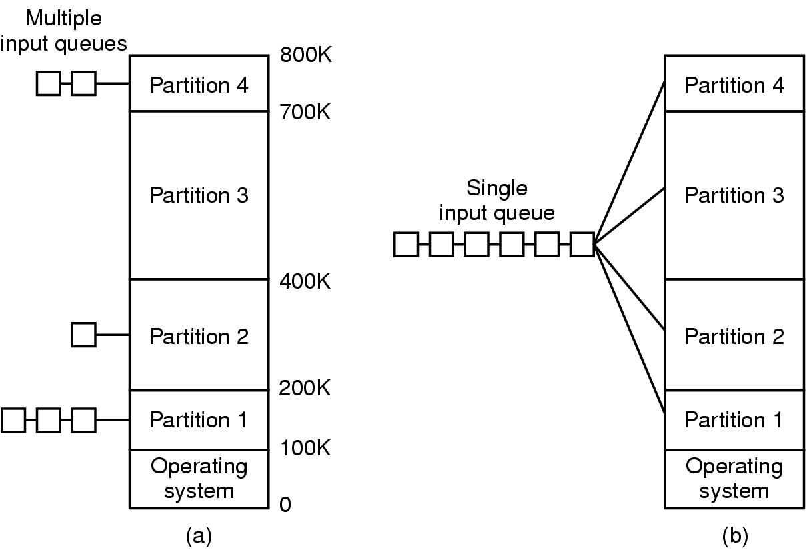
Multiprogramming with Fixed Partitions
If the job size < Partition size, memory is wasted
When a job arrives
  its put into the input queue of
The smallest partition large enough to hold the job

Slide 28
Multiprogramming with Fixed Partitions
Disadvantage of Multiple Queues:
  When a large partition is empty
  And queues for small partition is full
  Small jobs have to wait, even though plenty of memory is free
Alternative: Maintain a single Queue

Slide 29
Multiprogramming with Fixed Partitions
Whenever a partition becomes free, a job is selected
  Closest to the front of the queue
  Smaller than the partition size
Undesirable to waste a large partition for smaller job
  Search the queue, find the largest job that fits is
Unfair for smaller jobs
  A job may not be skipped more than k times
800K
Partition 4
700K
Partition 3
400K
Partition 2
200K
Partition 1
Operating System
100K
0

Slide 30
Fragmentation
External Fragmentation – total memory space exists to satisfy a request, but it is not contiguous
Internal Fragmentation – allocated memory may be slightly larger than requested memory; this size difference is memory internal to a partition, but not being used
First fit analysis reveals that given N blocks allocated, 0.5 N blocks lost to fragmentation
  1/3 may be unusable -> 50-percent rule

Slide 31
Internal Fragmentation
Memory that is internal to a partition but not being used
800K
Partition 4
B
Internal Fragmentation
700K
A
Partition 3
Internal Fragmentation
400K
Partition 2
200K
Partition 1
Operating System
100K
0

Slide 32
Swapping
If not enough space in memory for all the currently active processes
Excess processes must be kept on disk
  Fully ➔ Swapping
  Partially ➔ Virtual Memory
Example of Swapping
  Round Robin Scheduling
When the quantum expires
  Swap out the currently running process
  Swap in another process to freed memory space

Slide 33
Swapping
Another Example:
  Priority based scheduling
If a higher priority process arrives
  Swap out a lower priority process
  Swap in the higher priority process
When the higher priority process exits
  Swap in the lower priority process

Slide 34
Swapping
C
The number, size and location of the partition is decided dynamically.
D
B
B
A
C
A
A
D
Operating System
D is of Higher Priority, A is of Lower Priority!!!
B exits now, Swap in A

Slide 35
Swapping
Its possible to combine all the holes into one big hole
This is called COMPACTION
E
EXTERNAL FRAGMENTATION
Memory External to all partitions is Fragmented
Enough total memory exists to satisfy the request
But is not Contiguous
C
A
E
Swapping has created Holes
D
Operating System
D exits now
No Space for E !!!
Now E has enough space

Slide 36
Compaction
Compaction involves CPU overhead
If addresses are not generated relative to the partition location:
  Then Compaction is not possible
How much memory should be allocated for a process?
  If all the memory is allocated statically in a program
  Then, OS knows exactly the amount of memory to be allocated: executable code + variables
However, if memory is allocated dynamically (say using new)

Slide 37
Memory allocation for Processes
Problem may occur whenever a process tries to grow
If a hole is adjacent to the growing process then it can be allowed to grow
If another process is adjacent to the growing process, then
  The growing process should be moved to a larger hole
  If a larger hole is not available, then, one or more processes should be swapped out
  If a process cannot be swapped out (say, there is not enough space on disk
    The growing process has to wait
    Or should be killed!!!

Slide 38
Memory allocation for Processes
If most of the processes grow as they run,
It is better to allocate a little extra memory for a process
B
Room for growth
Actual in use
A
Room for growth
Actual in use
Operating System

Slide 39
Memory allocation for Processes
If processes have two growing segments
  Data
    (as heap for dynamically allocated variables)
  Stack
B-Stack
B-Data
B-Program
Room for growth
The memory can be used by either of the two segments
If it runs out the process either
  Has to be moved to a larger hole
  Or swapped out
  Or Killed
A-Stack
A-Data
A-Program
Room for growth
Operating System

